Slide 1

Software Design Principles: A Guide
Software design principles offer a framework for creating maintainable, scalable, and robust software. They guide developers towards well-structured and efficient code, leading to better software quality and reduced development time.
by Sowmiya Vijayan
SV

Slide 2
The SOLID Principles
1
Single Responsibility Principle
2
Open/Closed Principle
3
Liskov Substitution Principle
Software entities should be open for extension but closed for modification, allowing for flexibility and adaptability.
Subtypes should be substitutable for their base types without altering the correctness of the program.
Each class or module should have only one specific responsibility, keeping code focused and reducing complexity.
4
Interface Segregation Principle
5
Dependency Inversion Principle
Clients should not be forced to depend on interfaces they don't use, promoting modularity and efficiency.
High-level modules should not depend on low-level modules. Both should depend on abstractions.

Slide 3
Separation of Concerns
Benefits
Implementation
Example
Reduced complexity, increased maintainability, easier testing, promotes reusability.
Divide software into distinct parts, each addressing a specific aspect of the system's functionality.
User interface, data access layer, business logic, error handling.

Slide 4

Modularity and Encapsulation
Modularity
Encapsulation
Breaking down a system into smaller, independent units called modules, each responsible for a specific functionality.
Hiding the internal implementation details of a module and exposing only a well-defined interface to interact with it.
Advantages
Improved maintainability, reduced complexity, increased reusability, enhanced flexibility.

Slide 5
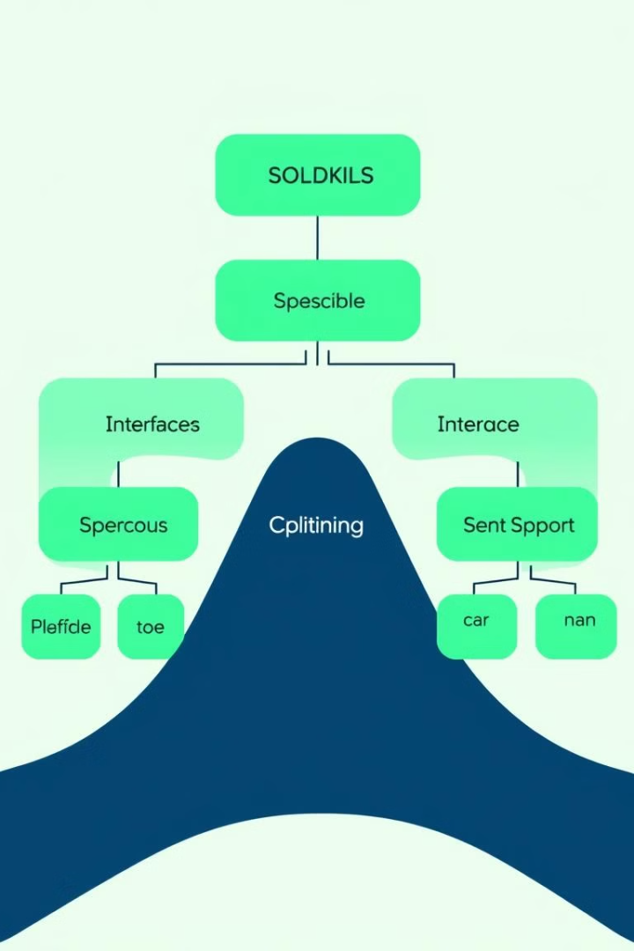



Abstraction and Interfaces
Abstraction
Simplifying complex systems by representing only essential information and hiding unnecessary details.
Interfaces
Defining contracts that specify the behavior of objects, without revealing their concrete implementation.
Benefits
Increased flexibility, promotes loose coupling, supports polymorphism, facilitates code reuse.

Slide 6
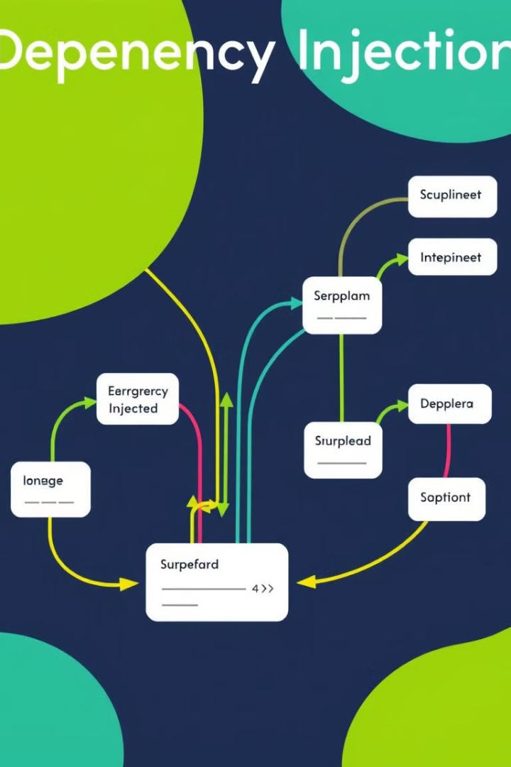
Dependency Injection
1
Concept
Injecting dependencies into objects instead of letting them create their own.
2
Advantages
Improved testability, reduced coupling, enhanced flexibility, easier to manage dependencies.
3
Implementation
Using constructor injection, setter injection, or method injection to provide dependencies.

Slide 7

Design Patterns
Pattern
Description
Example
Singleton
Ensures a class has only one instance and provides a global point of access to it.
Database connection manager.
Factory Method
Defines an interface for creating objects, but lets subclasses decide which class to instantiate.
Creating different types of vehicles in a car factory.
Observer
Defines a one-to-many dependency between objects, where changes to one object notify all its dependents.
Email notifications for changes in an online store.

Slide 8





Conclusion and Key Takeaways
Maintainability
Scalability
Reusability
Collaboration
Design principles lead to easier maintenance, reduced bugs, and faster code updates.
Well-designed software can easily adapt to future changes and handle increased complexity.
Modular design promotes code reuse, saving development time and effort.
Consistent design principles facilitate teamwork and shared understanding among developers.

Slide 9

THANK YOU
Thank you for your time and interest. We hope this presentation has provided valuable insights into the importance of software design principles.

